Slide 1
Neural Network Application to AirU
Timothy Quah

Slide 2
Progress Summary for 06/18/2019
Learned how to use Keras with Tensor flow backend
Practiced training and validation of Neural Networks on DAQ Data set
Trained and Validated Neural Network on AirU data

Slide 3
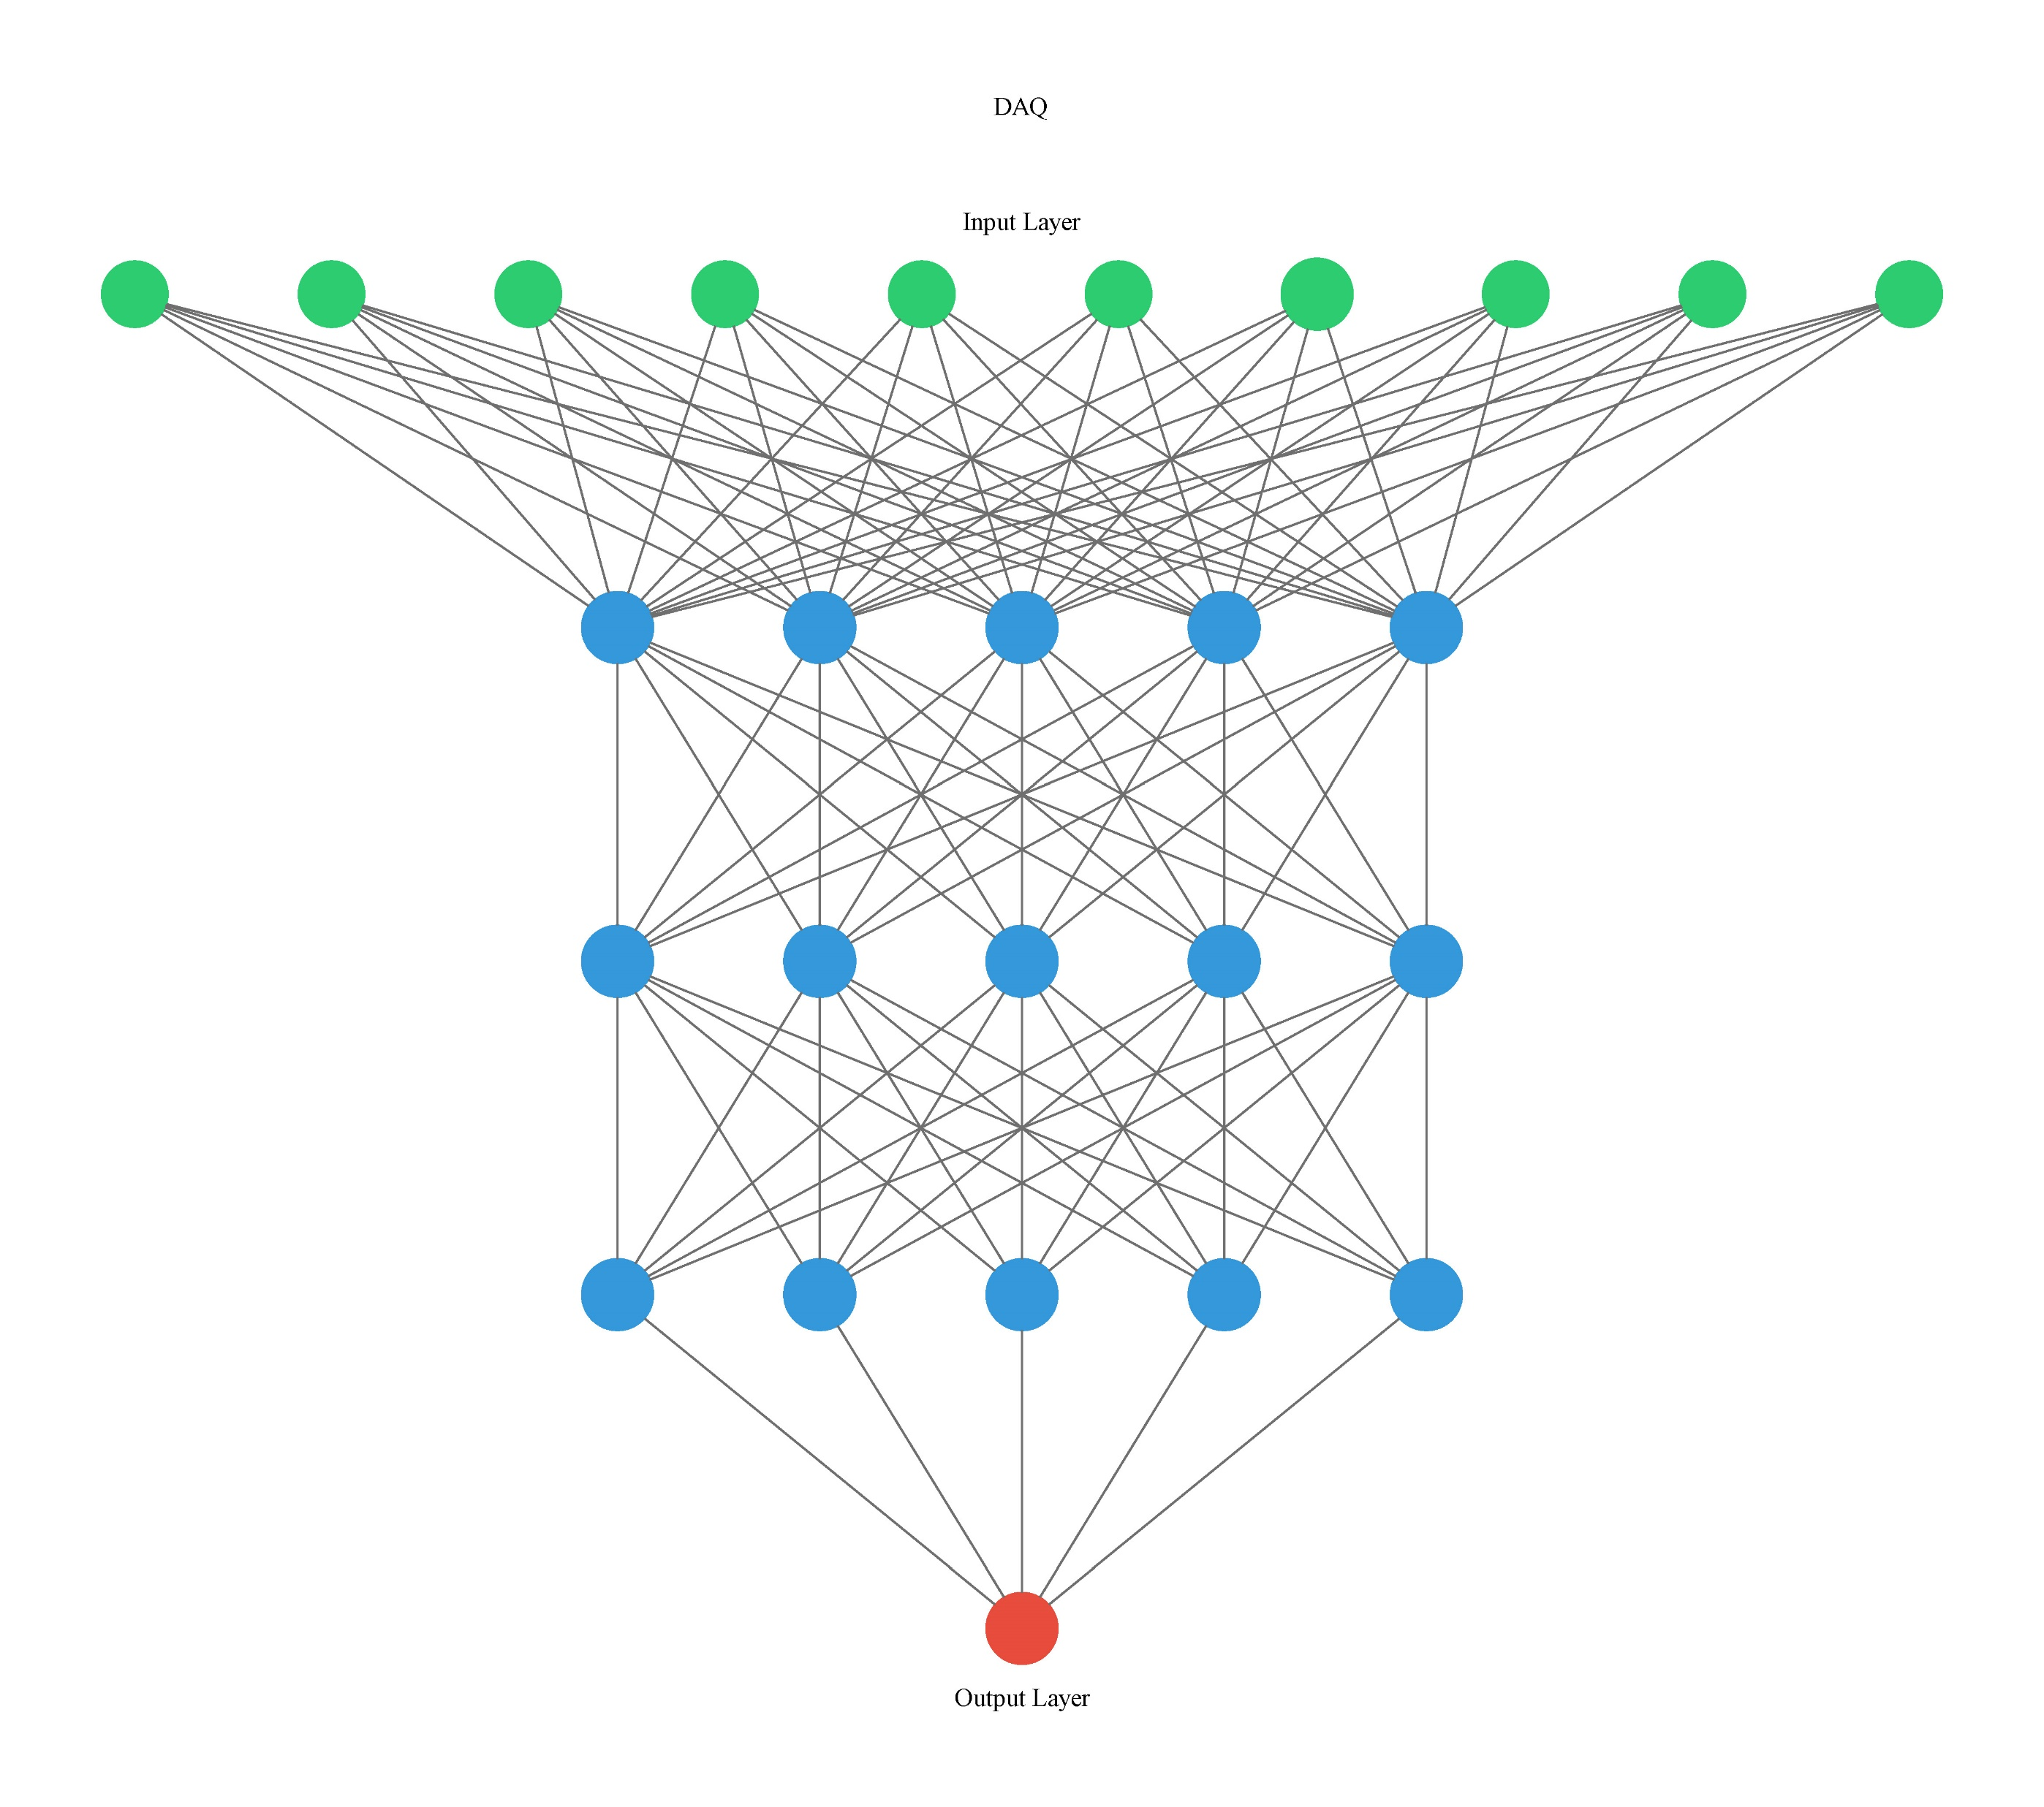
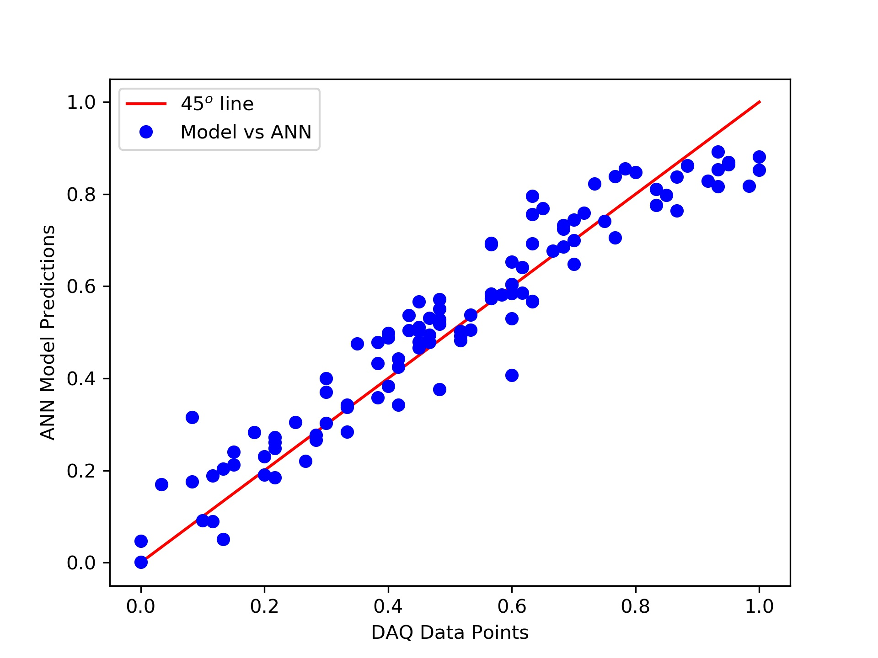

Neural Network Practice: DAQ Data for O₃
$$r^{2}=0.9054$$

Slide 4
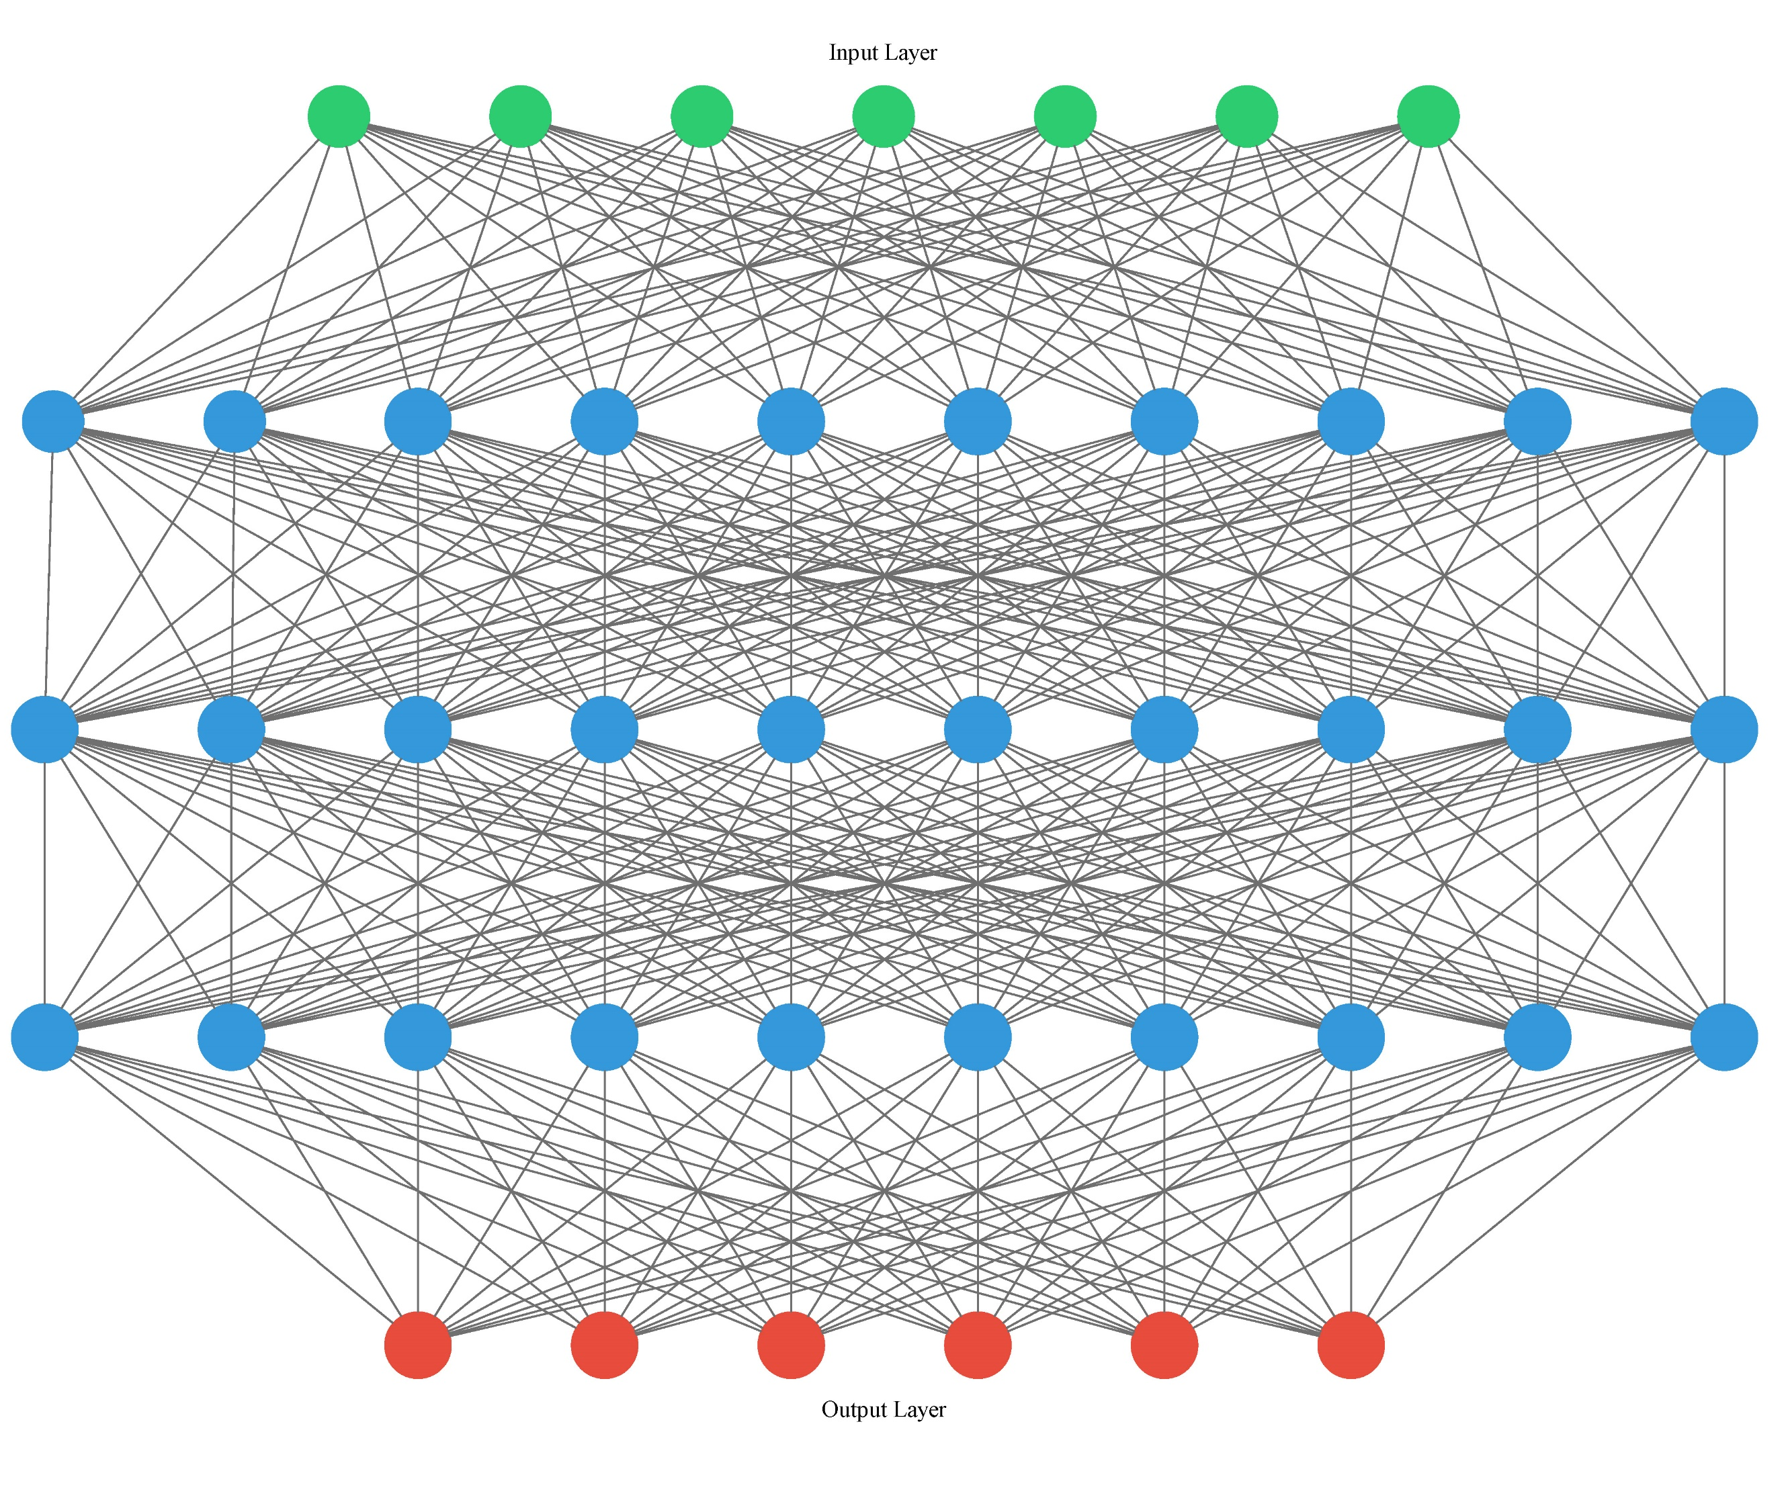
Air-Q Preliminary Neural Network
Input:
RH | Temp | CO | NO₂ | PM 2.5 | PM 1 | PM 10
Using Air Q variables as inputs and yielding an output that is compared with DAQ
Output:
RH | Temp | CO | NO₂ | O₃ | PM 2.5

Slide 5
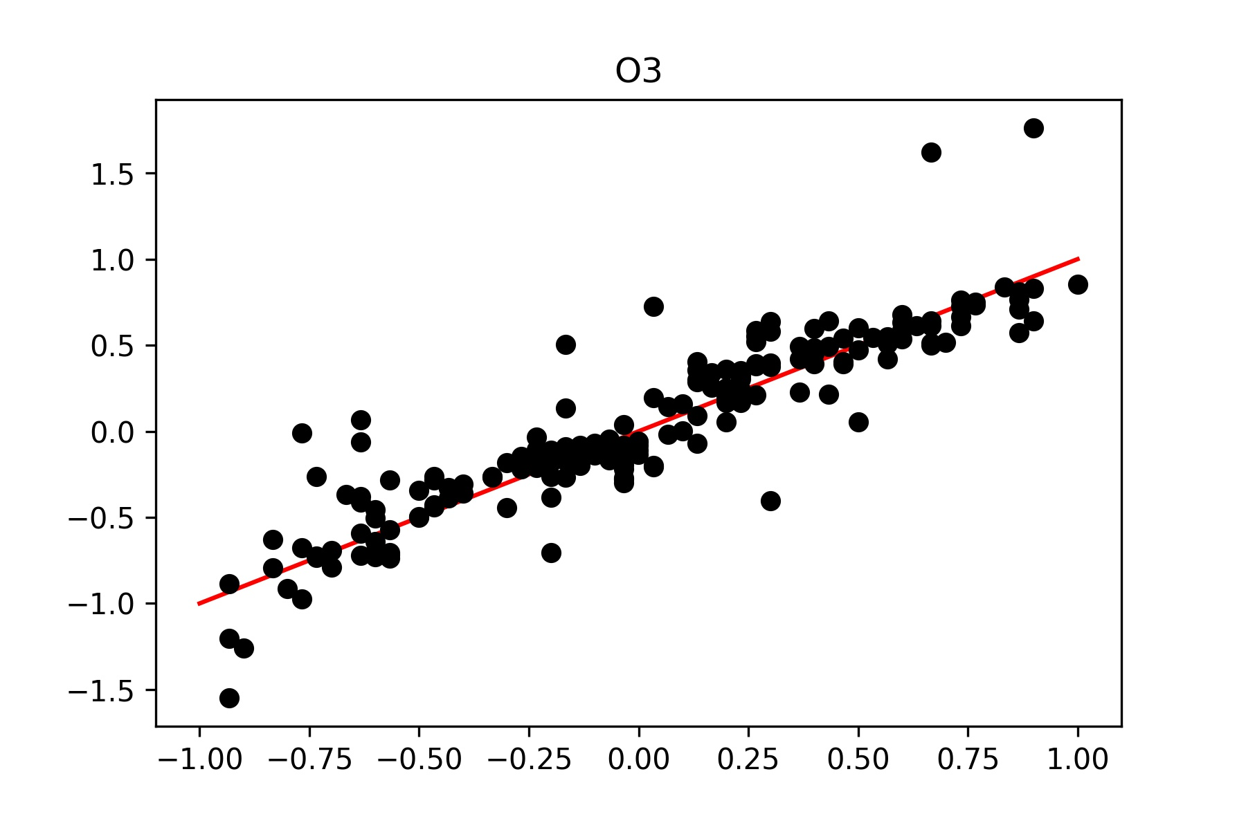
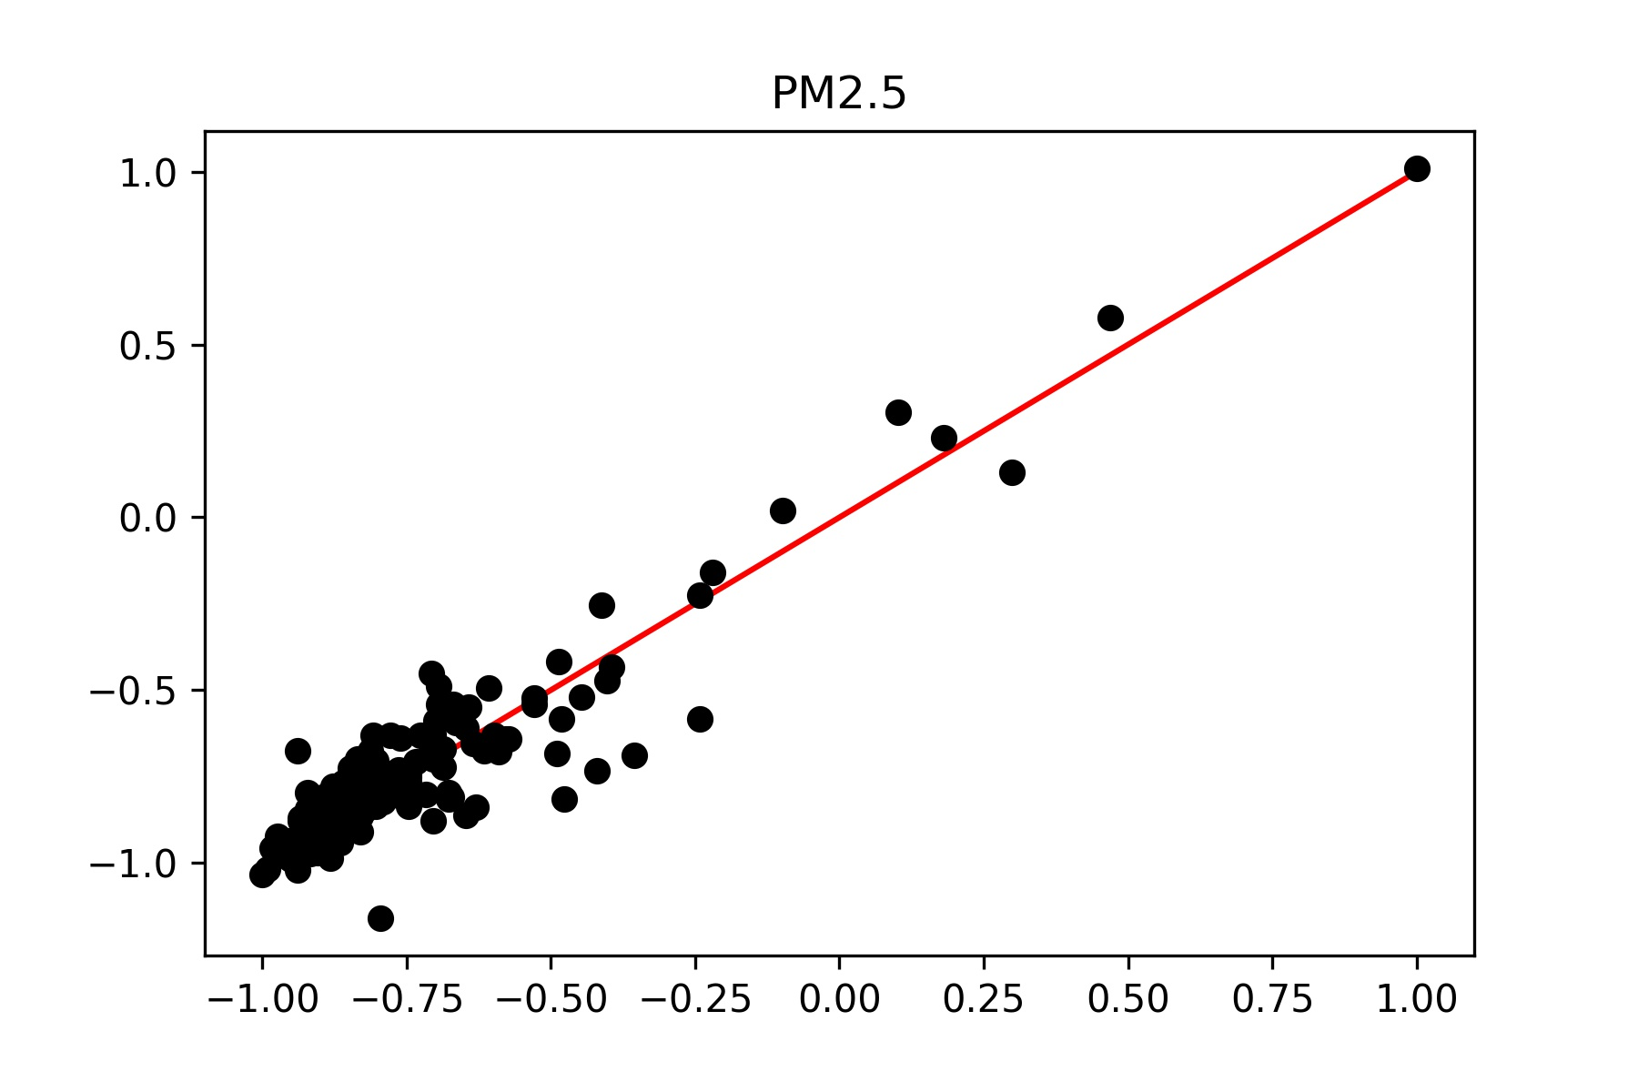
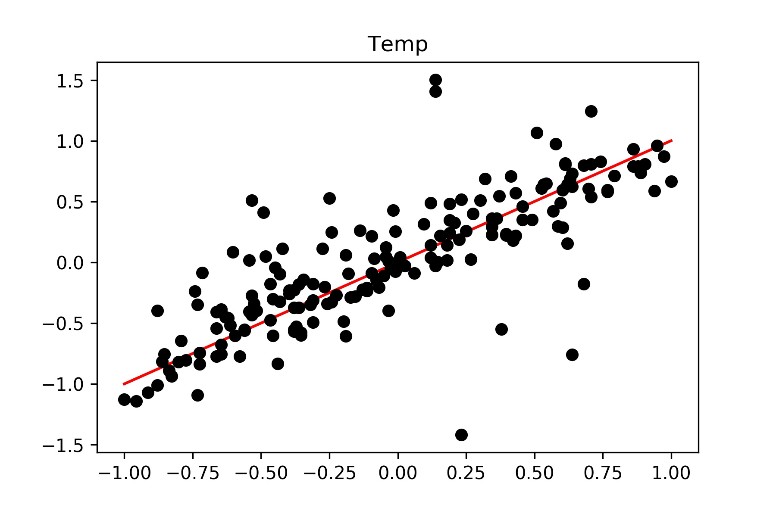
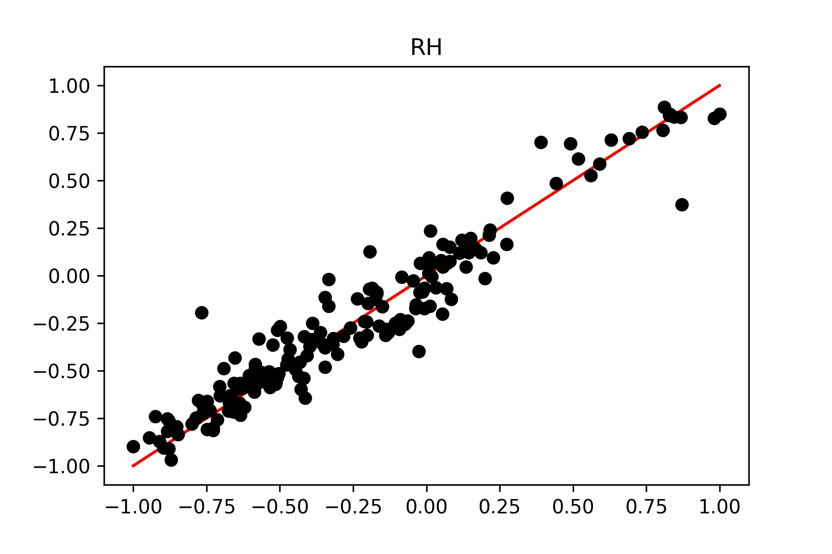
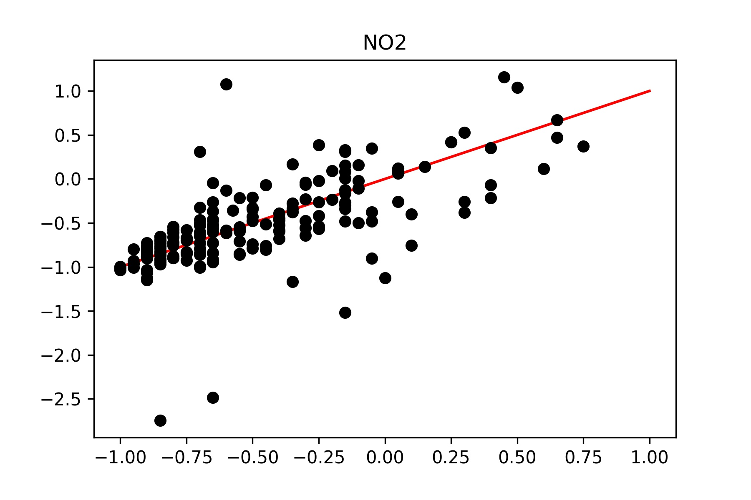
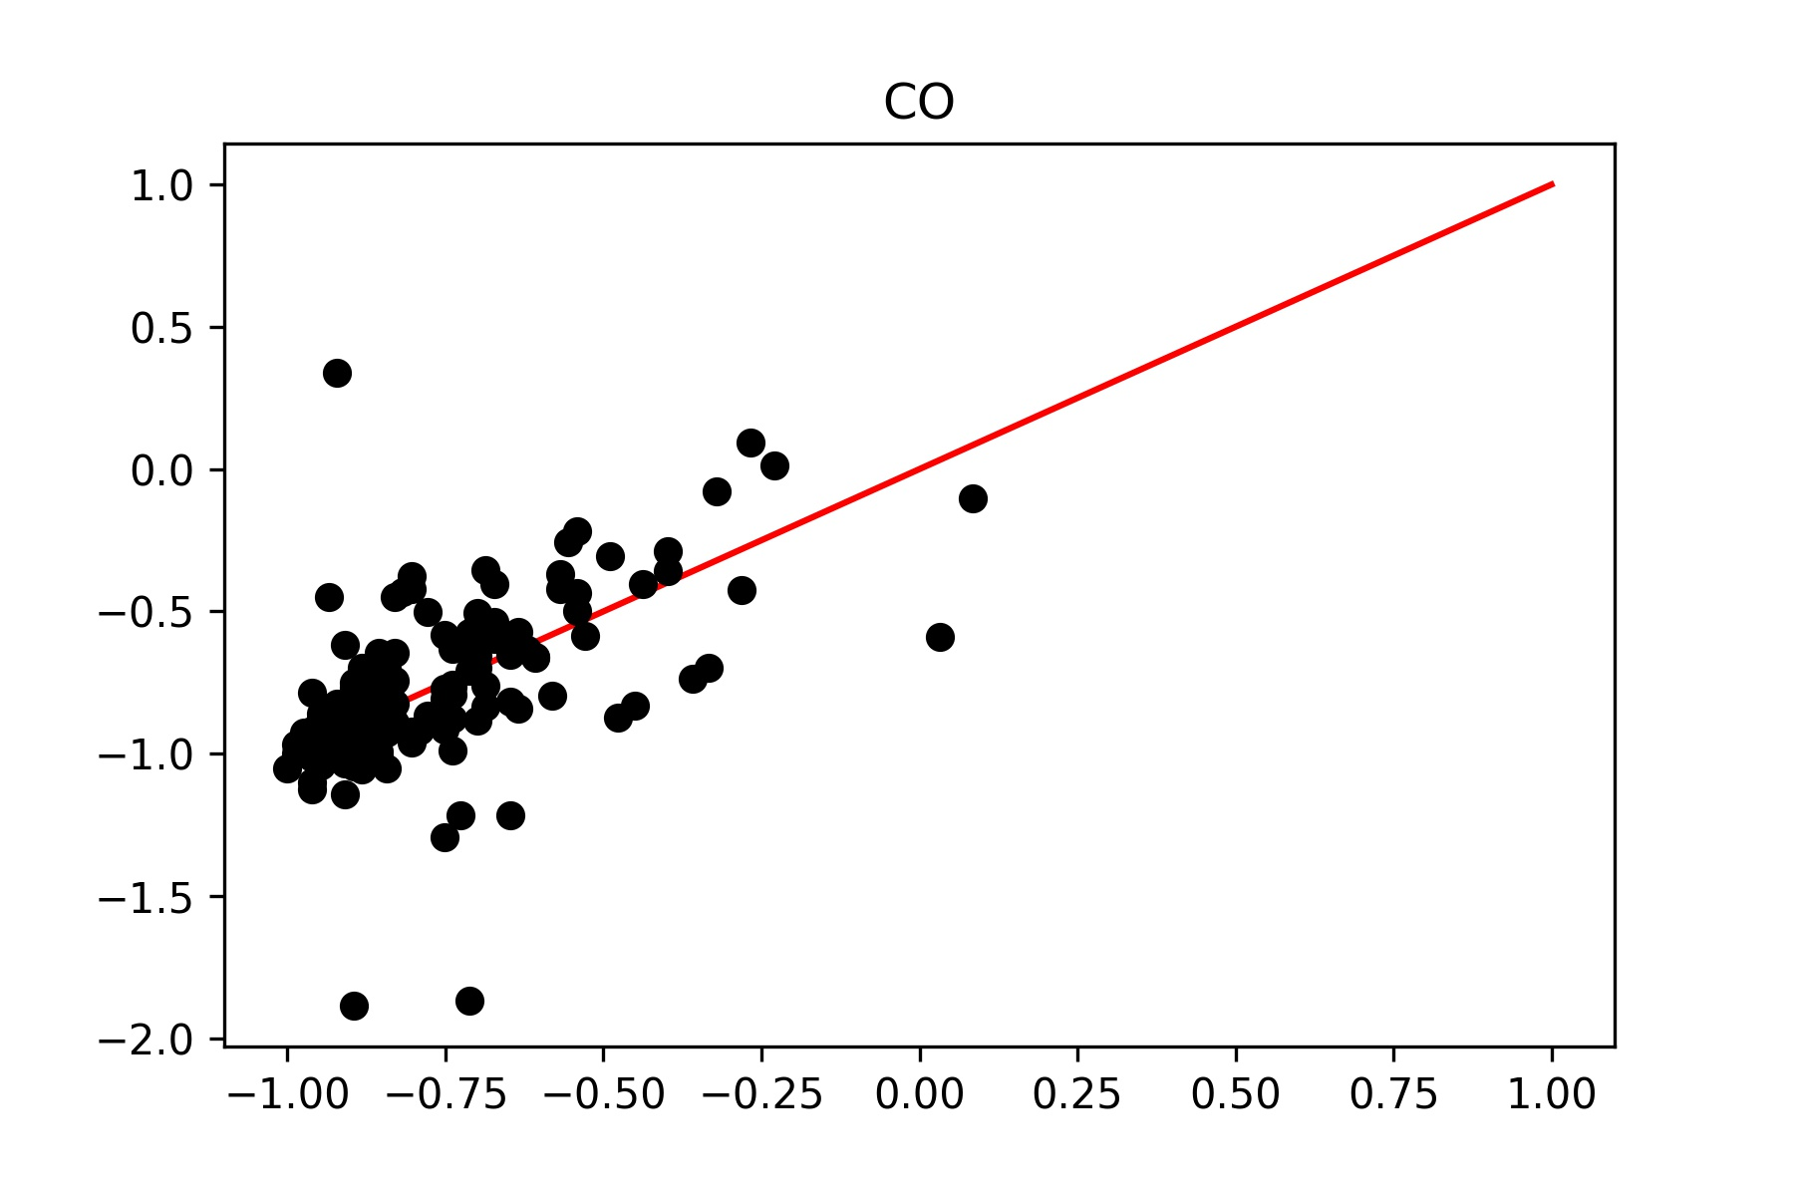

$$r^{2}=0.902$$
Good fit, but model focuses its effort on Temp and RH should create weighted error function that weights O3/NO2/CO more. Additionally with the new data time of day/month/day of the week (weekend or workday) will be added into the model.

